Slide 1

Introduction to Bioinformatics online course: IBT_2021
Module 5 Genomics
Human genetic variation

Slide 2
Learning objectives
After this session, participants should be able to:
Distinguish different types and consequences of genetic variation
Differentiate between major human genetic variation sequencing projects
Describe the types of analyses people do with genetic variation
Read genetic variation data in commonly-used formats including VCF and HGVS and express their own data in these formats
Synthesise the considerations involved in variant prioritisation from a variant calling study
Carry out variant prioritisation using the Ensembl VEP and related tools

Slide 3
Short variants
Single nucleotide polymorphisms (SNP/SNV)
ref...TTGACGTA...
alt...TTGGCGTA...
Small insertions & deletions
ref...TTGACGTA...
ins...TTGAGCGTA...
del...TTG-CGTA...
indel...TTGGCTCGTA...
http://www.ensembl.org/info/genome/variation/prediction/classification.html

Slide 4
Structural variants
Copy number variation (CNV)
Inversion - nucleotide sequence inverted at same position
Translocation - nucleotide sequence moved to a new position
Ref
Gain
Loss
Ref
Invert
> > >
> > >
Ref
Translocated: same chromosome
Translocated: diff chromosome
http://www.ensembl.org/info/genome/variation/prediction/classification.html

Slide 5
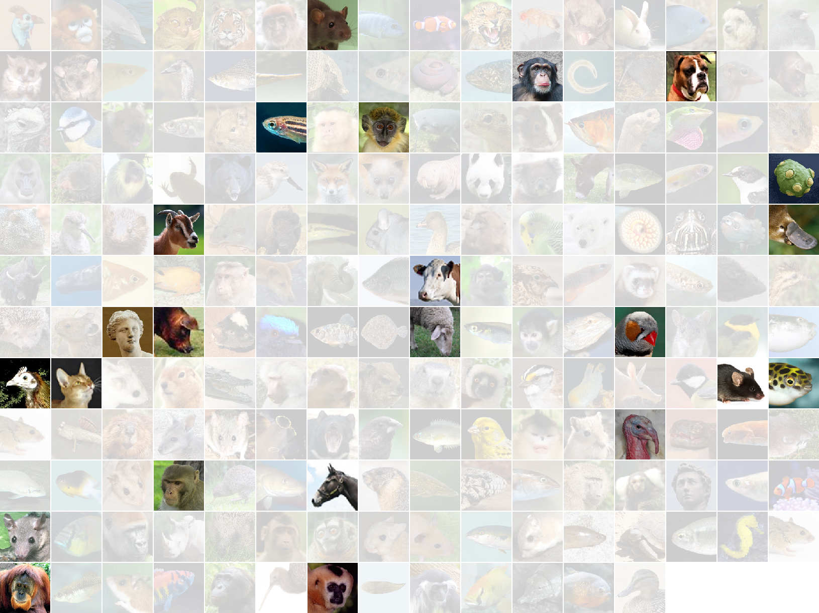
Genomes with variant data in Ensembl
http://www.ensembl.org/info/genome/variation/species/sources_documentation.html
Notes:
Practical applications
Breeding
Personalised medicine (disease diagnostics and pharmacogenomics)
Forensic science
Very frequent
In humans occur in 1 in every 300 bp
(~3 billion base pairs in mammalian genomes!)

Slide 6
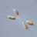




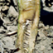
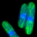

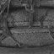
















Species with variant data in Ensembl Genomes
Ug99

Slide 7
The Ensembl variation process
Variant import
Quality control
Added value data
Ensembl analysis
Notes:
Data highly heterogeneous. Only public data loaded – ids and link out URL to restricted sources available where possible

Slide 8



Ensembl variation process: Import
Variant import
Quality control
Added value data
Ensembl analysis
Import variant data from publicly available archives and data repositories
EVA
ensembl.org/info/genome/variation/sources_documentation.html
Notes:
Data highly heterogeneous. Only public data loaded – ids and link out URL to restricted sources available where possible

Slide 9
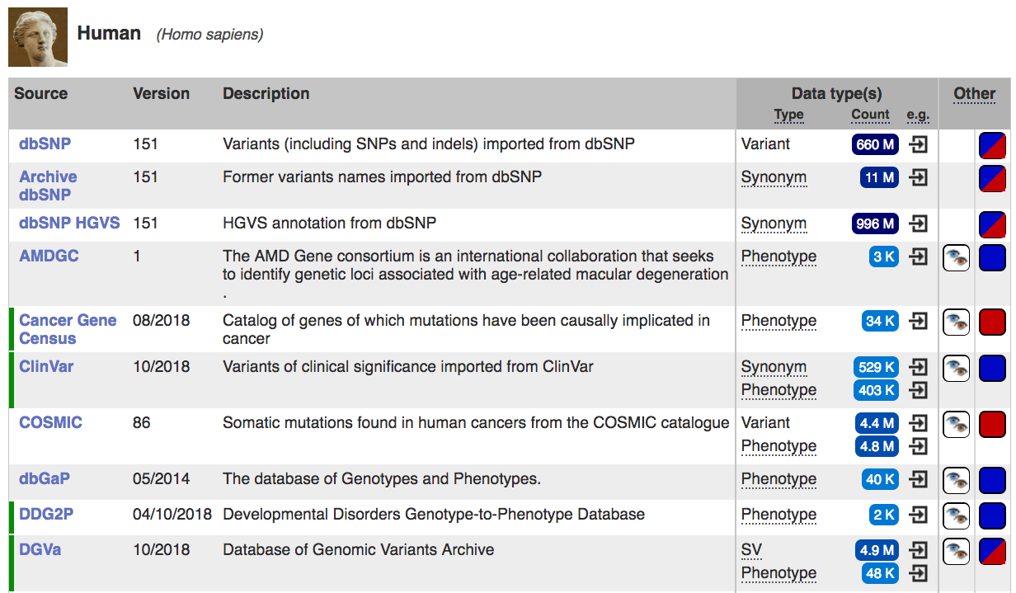
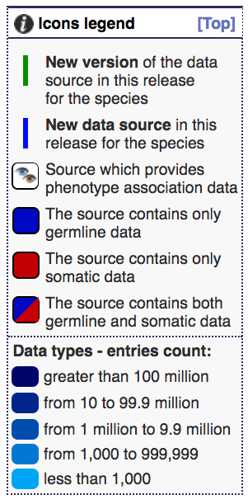
Import: Somatic and germline variants
http://www.ensembl.org/info/genome/variation/species/sources_documentation.html

Slide 10
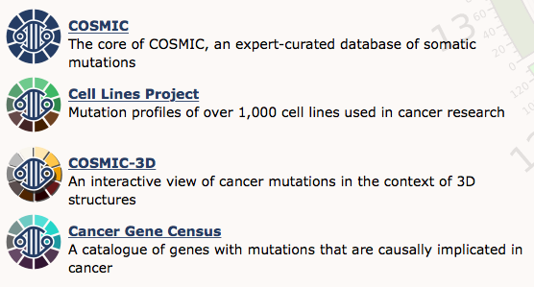
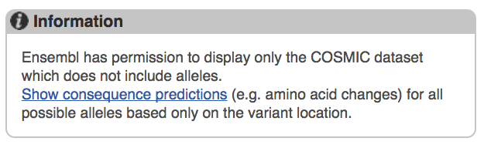
Import: Somatic mutation resources
A note about COSMIC data:
Therefore there is no allele frequency or population information displayed in Ensembl from COSMIC variants.

Slide 11
Ensembl variation process: QC
Variant import
Quality control
Added value data
Ensembl analysis
Mapping to reference assembly
GRCh37 GRCh38
Checks on alleles
Checks for IUPAC ambiguity codes
Excluding ‘suspect’ variants
ensembl.org/info/genome/variation/data_description.html#quality_control
Notes:
Data highly heterogeneous. Only public data loaded – ids and link out URL to restricted sources available where possible

Slide 12

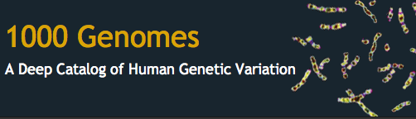





Ensembl variation process: Added value data
VEP
Web Site
Biomart
Perl API
REST API
Variant import
Quality control
Added value data
Ensembl analysis
Import further information about the variants
Phenotype/disease
Allele frequencies
Publication data
ensembl.org/info/genome/variation/sources_phenotype_documentation.html
Notes:
Data highly heterogeneous. Only public data loaded – ids and link out URL to restricted sources available where possible

Slide 13
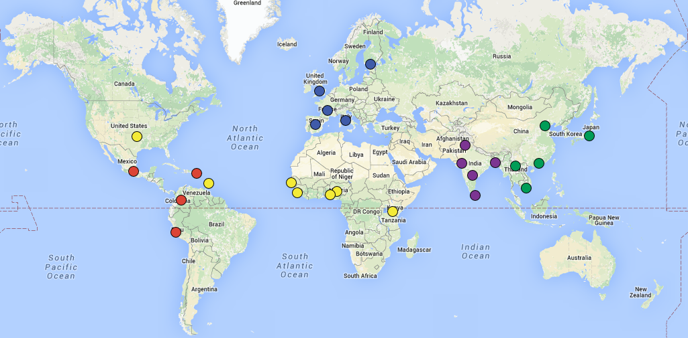
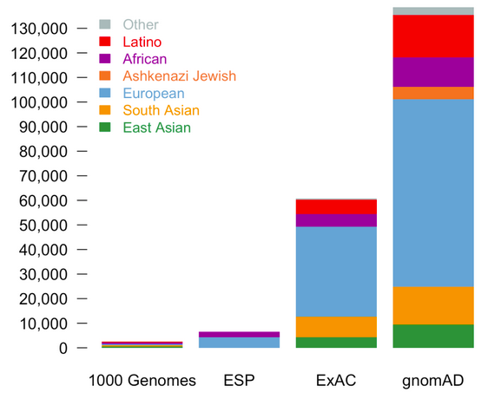
Added value data: population frequencies
Variant import
Quality control
Added value data
Ensembl analysis
1000 Genomes: worldwide healthy WGS
gnomAD: mixed disease/healthy WGS and exomes, skewed to most studied populations (included ExAC)
1000 Genomes populations

Slide 14



Ensembl variation process: Analysis
Variant import
Quality control
Added value data
Ensembl analysis
Ensembl predicts:
Variant consequences
Protein function prediction
Linkage disequilibrium data
Variant conservation across species
ensembl.org/info/genome/variation/predicted_data.html
Notes:
Data highly heterogeneous. Only public data loaded – ids and link out URL to restricted sources available where possible

Slide 15
Variant consequences
CODING
Synonymous
CODING
Missense
Regulatory
ATG
AAAAAAA
5’ Upstream
5’ UTR
Splice site
Intronic
3’ UTR
3’ Downstream

Slide 16
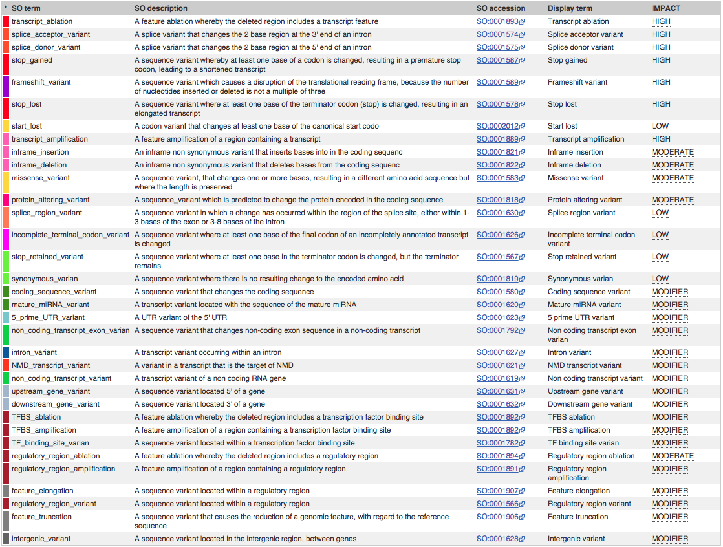
SO consequence terms
http://www.ensembl.org/info/docs/variation/predicted_data.html

Slide 17
Predicting missense effects
Various algorithms score or rank changes in amino acid sequence based on:
How well conserved the protein is
The chemical change in the amino acid
3D structure and domains
These are predictions, not facts
A prediction will never be as good as experimental validation

Slide 18
SIFT
PolyPhen2
CADD
1
1
100
Probably damaging
0.908
Possibly damaging
Likely deleterious
Tolerated
0.446
30
Benign
Likely benign
0.05
Deleterious
0
0
0

Slide 19
REVEL
MetaLR
MutationAssessor
1
1
1
Damaging
High
0.93
Likely disease causing
0.81
Medium
0.5
0.52
Low
Likely benign
Tolerated
0.20
Neutral
0
0
0

Slide 20
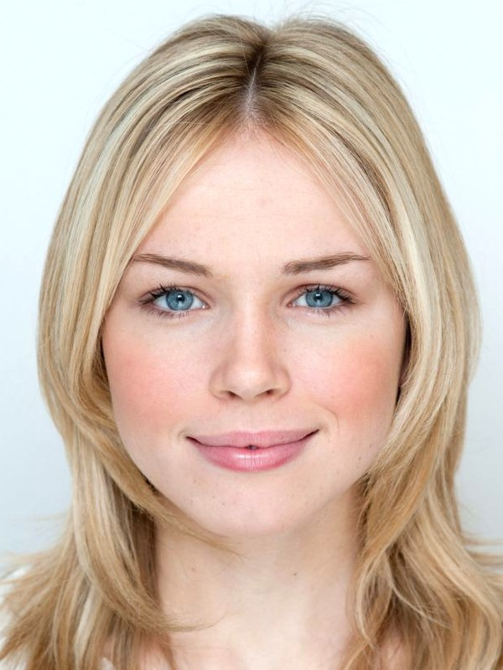



Reference/Alternative alleles
BL001
BL001
BL
AL002
AGTCGTAGCTAGCTAGGCCATAGGCGA
Reference allele = T
Alternative allele = anything other than T
AL
CM003
CM
IM004
IM

Slide 21
Major/Minor alleles
A|A
A|T
A|A
T|T
T|T
T|T
A|T
A|T
A|A
A|A
A|A
A|A
A|A
A|C
A|T
A|T
T|T
A|A
Major allele = A, frequency = 61%
Minor allele = T, frequency = 36%
Rare allele = C, frequency = 3%

Slide 22


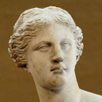
Ancestral/derived allele
AGTCG--GCTAGCAAGGCCATCGGCGA
AGTCG--GCTAGCAAGGCCATAGGCGA
AGTCGTAGCTAGCTAGGCCATAGGCGA
Ancestral allele = A
Derived allele = T

Slide 23
Reference ≠ Major ≠ Ancestral

Slide 24

Why we don’t use “wildtype/mutant” to refer to humans...

Slide 25





Allele strand
AGTCGTAGCTAGCT/GAGGCCATAGGCGA
TCGCCTATGGCCTA/CGCTAGCTACGACT
Exon sequence:
TATGGCCTA/CGCTAGC
Alleles in database = T/G
Alleles in gene = A/C
Alleles = A/C or T/G
Often lack further info

Slide 26
Ensembl variation process
Variant import
Quality control
Added value data
Ensembl analysis
Where can I find these data?
Website www.ensembl.org
Variant Effect Predictor (VEP)
BioMart
Programmatically:
Perl API (including VEP)
REST API
Notes:
Data highly heterogeneous. Only public data loaded – ids and link out URL to restricted sources available where possible

Slide 27
Hands on
Demo
We’re going to look at a gene AGT to find variants in the gene and the region it is found in.
We will look at a variant rs699 to find more information about it.
Task
Please complete task 1.

Slide 28
Variation formats

Slide 29
Variant identifiers
Format | Example | About | Comments
Genomic coordinates | chr1 230710048 A/C | Expresses the location of the variant on the reference genome | Unambiguous, so long as you state which reference
rsID | rs699 | ID assigned by dbSNP | Unambiguous, location and alleles in database
HGVS | ENST00000366667.4:c.803T>C | Expresses the location of the variant in terms of a transcript or protein | Can be ambiguous if you don’t specify isoform or version
COSMIC ID | COSV55386593 | ID assigned by COSMIC for somatic variants | Unambiguous, location and alleles in database
SPDI | 10:68684738:G:A | Expresses the location of the variant on the reference genome | Unambiguous, so long as you state which reference

Slide 30
rsIDs
An rsID is a unique identifier for a variant
It refers to a specific variant which has information on:
Locus
Alleles
Other data (such as allele frequencies) can be attached to rsIDs

Slide 31
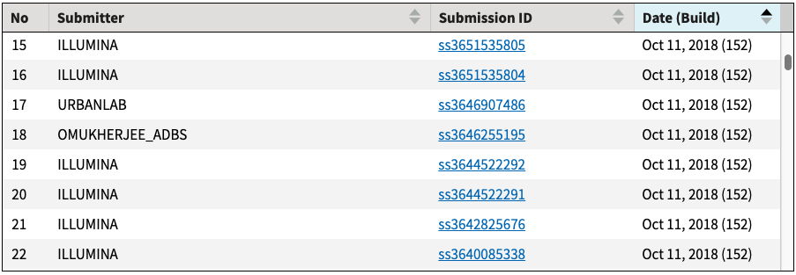
rsIDs
When you submit a variant into dbSNP, your submission is assigned an ssID (submitted SNP)
Multiple submissions of the same variant locus are used to create an rsID (reference SNP)
dbSNP store and display all the ssIDs used to make an rsID

Slide 32
VCF format
VCF is the standard format that you will get from variant calling pipeline
It must give information about:
Location
Alleles
It can also give a lot more information including:
Genotypes
Frequencies
Quality scores

Slide 33
A simplified VCF file
VCF is a tab separated file. The necessary columns are:
#CHROM POS ID REF ALT
X 154154734 rs104894912 C T
1 231694746 rs34622148 C T
12 107859209 rs1895946 C T
#CHROM | POS | ID | REF | ALT
X | 154154734 | rs104894912 | C | T
1 | 231694746 | rs34622148 | C | T
12 | 107859209 | rs1895946 | C | T

Slide 34
A full VCF file
In reality, they look like this:
##fileformat=VCFv4.1
##FILTER=<ID=PASS,Description="All filters passed">
##fileDate=20150218
##reference=ftp://ftp.1000genomes.ebi.ac.uk//vol1/ftp/technical/reference/phase2_reference_assembly_sequence/hs37d5.fa.gz
##source=1000GenomesPhase3Pipeline
##ALT=<ID=CNV,Description="Copy Number Polymorphism">
##ALT=<ID=DEL,Description="Deletion">
##ALT=<ID=DUP,Description="Duplication">
##ALT=<ID=INS:ME:ALU,Description="Insertion of ALU element">
##ALT=<ID=INS:ME:LINE1,Description="Insertion of LINE1 element">
##ALT=<ID=INS:ME:SVA,Description="Insertion of SVA element">
##ALT=<ID=INS:MT,Description="Nuclear Mitochondrial Insertion">
##ALT=<ID=INV,Description="Inversion">
##FORMAT=<ID=GT,Number=1,Type=String,Description="Genotype">
##INFO=<ID=CIEND,Number=2,Type=Integer,Description="Confidence interval around END for imprecise variants">
##INFO=<ID=CIPOS,Number=2,Type=Integer,Description="Confidence interval around POS for imprecise variants">
##INFO=<ID=CS,Number=1,Type=String,Description="Source call set.">
##INFO=<ID=END,Number=1,Type=Integer,Description="End coordinate of this variant">
##INFO=<ID=IMPRECISE,Number=0,Type=Flag,Description="Imprecise structural variation">
##INFO=<ID=MC,Number=.,Type=String,Description="Merged calls.">
##INFO=<ID=MEINFO,Number=4,Type=String,Description="Mobile element info of the form NAME,START,END<POLARITY; If there is only 5' OR 3' support for this call, will be NULL NULL for START and END">
##INFO=<ID=MEND,Number=1,Type=Integer,Description="Mitochondrial end coordinate of inserted sequence">
##INFO=<ID=MLEN,Number=1,Type=Integer,Description="Estimated length of mitochondrial insert">
##INFO=<ID=MSTART,Number=1,Type=Integer,Description="Mitochondrial start coordinate of inserted sequence">
##INFO=<ID=SVLEN,Number=.,Type=Integer,Description="SV length. It is only calculated for structural variation MEIs. For other types of SVs; one may calculate the SV length by INFO:END-START+1, or by finding the difference between lengthes of REF and ALT alleles">
##INFO=<ID=SVTYPE,Number=1,Type=String,Description="Type of structural variant">
##INFO=<ID=TSD,Number=1,Type=String,Description="Precise Target Site Duplication for bases, if unknown, value will be NULL">
##INFO=<ID=AC,Number=A,Type=Integer,Description="Total number of alternate alleles in called genotypes">
##INFO=<ID=AF,Number=A,Type=Float,Description="Estimated allele frequency in the range (0,1)">
##INFO=<ID=NS,Number=1,Type=Integer,Description="Number of samples with data">
##INFO=<ID=AN,Number=1,Type=Integer,Description="Total number of alleles in called genotypes">
##INFO=<ID=EAS_AF,Number=A,Type=Float,Description="Allele frequency in the EAS populations calculated from AC and AN, in the range (0,1)">
##INFO=<ID=EUR_AF,Number=A,Type=Float,Description="Allele frequency in the EUR populations calculated from AC and AN, in the range (0,1)">
##INFO=<ID=AFR_AF,Number=A,Type=Float,Description="Allele frequency in the AFR populations calculated from AC and AN, in the range (0,1)">
##INFO=<ID=AMR_AF,Number=A,Type=Float,Description="Allele frequency in the AMR populations calculated from AC and AN, in the range (0,1)">
##INFO=<ID=SAS_AF,Number=A,Type=Float,Description="Allele frequency in the SAS populations calculated from AC and AN, in the range (0,1)">
##INFO=<ID=DP,Number=1,Type=Integer,Description="Total read depth; only low coverage data were counted towards the DP, exome data were not used">
##INFO=<ID=AA,Number=1,Type=String,Description="Ancestral Allele. Format: AA|REF|ALT|IndelType. AA: Ancestral allele, REF:Reference Allele, ALT:Alternate Allele, IndelType:Type of Indel (REF, ALT and IndelType are only defined for indels)">
##INFO=<ID=VT,Number=.,Type=String,Description="indicates what type of variant the line represents">
##INFO=<ID=EX_TARGET,Number=0,Type=Flag,Description="indicates whether a variant is within the exon pull down target boundaries">
##INFO=<ID=MULTI_ALLELIC,Number=0,Type=Flag,Description="indicates whether a site is multi-allelic">
##source_20180126.1=vcf-subset(r940) -f -c HG01879,HG01880,HG01882,HG01883 100050000.ALL.chr1.phase3_shapeit2_mvncall_integrated_v5a.20130502.genotypes.vcf.gz
#CHROM POS ID REF ALT QUAL FILTER INFO FORMAT HG01879 HG01880 HG01882 HG01883
1 100000012 rs10875231 G T 100 PASS AA=G|||;AC=71;AF=0.301118;AFR_AF=0.3691;AMR_AF=0.2478;AN=192;DP=17508;EAS_AF=0.3224;EUR_AF=0.2465;NS=2504;SAS_AF=0.2812;VT=SNP GT 1|0 1|0 0|0 0|0
1 100000081 rs568254201 C T 100 PASS AA=C|||;AC=0;AF=0.000199681;AFR_AF=0;AMR_AF=0;AN=192;DP=17382;EAS_AF=0;EUR_AF=0.001;NS=2504;SAS_AF=0;VT=SNP GT 0|0 0|0 0|0 0|0
1 100000185 rs536935452 C T 100 PASS AA=C|||;AC=0;AF=0.000399361;AFR_AF=0;AMR_AF=0;AN=192;DP=18865;EAS_AF=0;EUR_AF=0;NS=2504;SAS_AF=0.002;VT=SNP GT 0|0 0|0 0|0 0|0
1 100000268 rs550897497 G T 100 PASS AA=G|||;AC=0;AF=0.000399361;AFR_AF=0.0015;AMR_AF=0;AN=192;DP=19048;EAS_AF=0;EUR_AF=0;NS=2504;SAS_AF=0;VT=SNP GT 0|0 0|0 0|0 0|0
1 100000320 rs570330528 A G 100 PASS AA=A|||;AC=0;AF=0.000199681;AFR_AF=0;AMR_AF=0;AN=192;DP=18631;EAS_AF=0.001;EUR_AF=0;NS=2504;SAS_AF=0;VT=SNP GT 0|0 0|0 0|0 0|0
1 100000421 rs190422219 G T 100 PASS AA=G|||;AC=0;AF=0.000199681;AFR_AF=0.0008;AMR_AF=0;AN=192;DP=18877;EAS_AF=0;EUR_AF=0;NS=2504;SAS_AF=0;VT=SNP GT 0|0 0|0 0|0 0|0
1 100000507 rs147509398 C A 100 PASS AA=C|||;AC=0;AF=0.000998403;AFR_AF=0.0038;AMR_AF=0;AN=192;DP=20071;EAS_AF=0;EUR_AF=0;NS=2504;SAS_AF=0;VT=SNP GT 0|0 0|0 0|0 0|0
1 100000625 rs572557926 C T 100 PASS AA=C|||;AC=0;AF=0.000199681;AFR_AF=0.0008;AMR_AF=0;AN=192;DP=21457;EAS_AF=0;EUR_AF=0;NS=2504;SAS_AF=0;VT=SNP GT 0|0 0|0 0|0 0|0
1 100000659 rs535185704 A G 100 PASS AA=A|||;AC=0;AF=0.000199681;AFR_AF=0.0008;AMR_AF=0;AN=192;DP=20946;EAS_AF=0;EUR_AF=0;NS=2504;SAS_AF=0;VT=SNP GT 0|0 0|0 0|0 0|0
1 100000675 rs554857373 A G 100 PASS AA=A|||;AC=0;AF=0.000199681;AFR_AF=0;AMR_AF=0;AN=192;DP=20896;EAS_AF=0;EUR_AF=0.001;NS=2504;SAS_AF=0;VT=SNP GT 0|0 0|0 0|0 0|0

Slide 35
A data line
#CHROM POS ID REF ALT QUAL FILTER INFO FORMAT HG01879 HG01880 HG01882 HG01883
1 100000012 rs10875231 G T 100 PASS AA=G|||;AC=71;AF=0.301118;AFR_AF=0.3691;AMR_AF=0.2478;AN=192;DP=17508;EAS_AF=0.3224;EUR_AF=0.2465;NS=2504;SAS_AF=0.2812;VT=SNP GT 1|0 1|0 0|0 0|0
individual genotypes
#CHROM | POS | ID | REF | ALT | QUAL | FILTER | INFO | FORMAT | HG01879 | HG01880 | HG01882 | HG01883
1 | 100000012 | rs10875231 | G | T | 100 | PASS | AA=G|||;AC=71;AF=0.301118;AFR_AF=0.3691;AMR_AF=0.2478;AN=192;DP=17508;EAS_AF=0.3224;EUR_AF=0.2465;NS=2504;SAS_AF=0.2812;VT=SNP | GT | 1|0 | 1|0 | 0|0 | 0|0

Slide 36
Genotypes
0 = reference
1 = alternative
2+ = second (or more) possible alternative
#CHROM POS ID REF ALT QUAL FILTER INFO FORMAT HG01879 HG01880 HG01882
1 100000827 rs6678176 C T 100 PASS n/a GT 1|1 1|0 0|0
HG01879 has the genotype T|T
HG01880 has the genotype T|C
HG01882 has the genotype C|C

Slide 37
Phased genotypes
A pipe | indicates that the genotypes are phased, which means we know which homologous chromosome they come from
We can calculate LD
We can determine the actual genomic sequence in this person
A slash / means that we don’t know

Slide 38
Phased genotypes
#CHROM POS ID REF ALT QUAL FILTER INFO FORMAT HG01879
1 100000827 rs6678176 C T 100 PASS n/a GT 1|1
1 100000843 rs78286437 T C 100 PASS n/a GT 0|1
HG01879 has two copies of 1:100000827-100000843. The sequences of these are:
TGTGATTCAGGACTTAT
TGTGATTCAGGACTTAC

Slide 39
The INFO column
The contents of the INFO column are defined in the header. Fields are separated by semi-colons.
AA=G|||;AC=71;AF=0.301118;AFR_AF=0.3691;AMR_AF=0.2478;AN=192;DP=17508;EAS_AF=0.3224;EUR_AF=0.2465;NS=2504;SAS_AF=0.2812;VT=SNP

Slide 40
The INFO column
The contents of the INFO column are defined in the header. Fields are separated by semi-colons.
AA=G|||;AC=71;AF=0.301118;AFR_AF=0.3691;AMR_AF=0.2478;AN=192;DP=17508;EAS_AF=0.3224;EUR_AF=0.2465;NS=2504;SAS_AF=0.2812;VT=SNP
##INFO=<ID=AA,Number=1,Type=String,Description="Ancestral Allele. Format: AA|REF|ALT|IndelType. AA: Ancestral allele, REF:Reference Allele, ALT:Alternate Allele, IndelType:Type of Indel (REF, ALT and IndelType are only defined for indels)">
The ancestral allele is G

Slide 41
The INFO column
The contents of the INFO column are defined in the header. Fields are separated by semi-colons.
AA=G|||;AC=71;AF=0.301118;AFR_AF=0.3691;AMR_AF=0.2478;AN=192;DP=17508;EAS_AF=0.3224;EUR_AF=0.2465;NS=2504;SAS_AF=0.2812;VT=SNP
##INFO=<ID=AFR_AF,Number=A,Type=Float,Description="Allele frequency in the AFR populations calculated from AC and AN, in the range (0,1)">
The frequency of the alternative allele of this variant in the AFR population is 36.91%

Slide 42
Full VCF specs
SAMtools publish the full specs for VCF including details on:
short indels
simple and complex SVs
what can be included in the INFO column
https://samtools.github.io/hts-specs/VCFv4.3.pdf

Slide 43
HGVS notation
HGVS notation describes variants in terms of the CDSs and proteins they fall within
A CDS example ENST00000255409.7:c.433A>G
A protein example ENSP00000255409.3:p.Arg145Gly
It consists of the identifier of the feature they fall within, followed by the change.
Detailed documentation at http://varnomen.hgvs.org/

Slide 44
HGVS CDS notation
ENST00000255409.7:c.433A>G
ENST00000255409.7 | The Ensembl identifier of the transcript hit, including the version number
:c. | This indicates that this represents the position in the CDS
433 | The position within the CDS
A>G | The base change at that position. Note that these bases will be those in the strand that the transcript is transcribed from.

Slide 45
HGVS protein notation
ENSP00000255409.3:p.Arg145Gly
ENSP00000255409.3 | The Ensembl identifier of the protein hit, including the version number
:p. | This indicates that this represents the position in the protein
Arg | The reference amino acid at this position
145 | The position within the protein
Gly | The alternative amino acid

Slide 46
Problems with HGVS: ambiguity
Transcript and protein identifiers with version numbers (eg Ensembl ENST00000255409.7 or RefSeq NM_001276.2) are unambiguous.
However many people express HGVS with gene names, eg CHI3L1:p.Arg145Gly
Which protein isoform are they referring to?
Which version?

Slide 47
Problems with HGVS: repeat shifting
123456789012345678
ref: AAGTCTCGGGGTCATTGC
alt: AAGTCTCGGGTCATTGC
In VCF format, deletions of repeats are shifted left. This would be encoded as:
chr 7 id CG C
In HGVS format, deletions of repeats are shifted right. This would be encoded as:
chr:g.11del
If a variant is referred to by two different locations, it might not be identified as the same variant, eg a phenotype and variant frequency might not be linked.

Slide 48
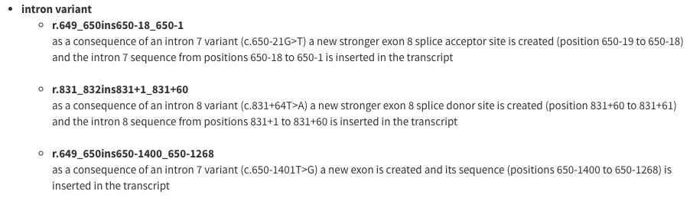
Problems with HGVS: complication
The rules for HGVS nomenclature can get insanely complicated.

Slide 49
Ensembl VEP
Annotate your own variants

Slide 50
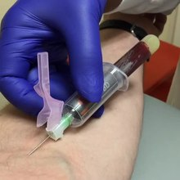
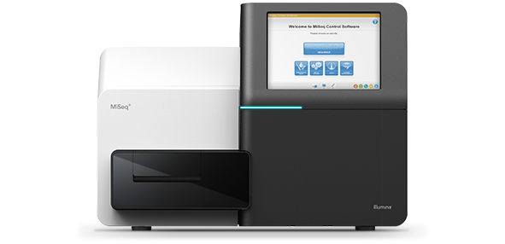
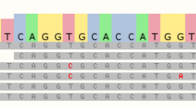
What is variant annotation?
#CHROM POS ID REF ALT
20 14370 . G A
20 17330 . T A
Meaning

Slide 51

What is the VEP for?
#CHROM POS ID REF ALT
20 14370 . G A
20 17330 . T A
Probably damaging
CODING
Synonymous
CODING
Missense
Regulatory
ATG
AAAAAAA
Possibly damaging
Benign
5’ Upstream
5’ UTR
Splice site
Intronic
3’ UTR
3’ Downstream

Slide 52
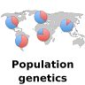

What is the VEP for?
#CHROM POS ID REF ALT
20 14370 . G A
20 17330 . T A
#CHROM POS ID REF ALT
20 14370 rs6054257 G A
/

Slide 53
VEP input
Variant coordinates | 1 881907 881906 -/C + 5 140532 140532 T/C + 12 1017956 1017956 T/A +
HGVS notation | ENST00000285667.3:c.1047_1048insC 5:g.140532T>C NP_000050.2:p.Ile2285Val
VCF | #CHROM POS ID REF ALT 20 14370 rs6054257 G A 20 17330 . T A
Variant IDs | rs41293501 COSM327779 rs146120136
SPDI | 16:68684738:G:A 11:43092199:GCTTTT: 13:32315789::C

Slide 54
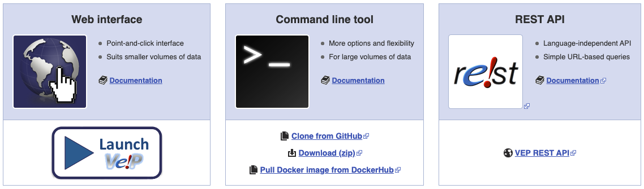
Ways to use the VEP
Very easy to use ✅
Not suitable for large data volumes ❌
Can be difficult to set up ❌
Can use with (multi-)genome-wide data ✅
Can work completely offline ✅
Language agnostic ✅
GET and POST options allow up to 200 variants as input
Ideal for embedding in web-pages or using as part of a pipeline ✅

Slide 55


VEP caches
Input data
Internet speed
Load on our database
Data over the internet
Your computer
Ensembl databases
Output data
Your computer
All data the VEP needs in one small(ish) package
No internet connectivity needed
VEP cache

Slide 56
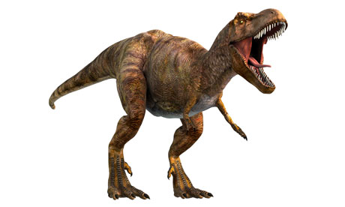
VEP caches
Use prebuilt caches for Ensembl species.
Download with the installation script
Or make your own from GTF and FASTA files - even for genomes not in Ensembl.
http://www.ensembl.org/info/docs/tools/vep/script/vep_cache.html

Slide 57

VEP plugins
Plugins add extra functionality to the VEP
They may extend, filter or manipulate the output of the VEP.
Plugins may make use of external data or code.
Available on the web tool and with the script.

Slide 58
More information
The Ensembl Variant Effect Predictor.
McLaren et al. 2016
http://europepmc.org/abstract/MED/27268795

Slide 59
Hands on
Demo
We’re going to look at a vcf of variants from whole genome sequencing:
genomics.human_genetic_variation.DemoVEP.vcf
We’re going to run these variants through the VEP to identify which genes were affected
Task
Please complete task 2.

Slide 60
Variant prioritisation
The VEP tells us:
which genes are affected by variants
how those genes are affected
if the variant is known and frequency information
We can use the VEP results and information in Ensembl to identify variants that might be causal
Further experiments are needed to determine if this is the case
This is variant prioritisation, not variant selection

Slide 61
Considerations
Consequence of the variant on genes
Known phenotypes associated with the variant and/or gene
Function of the gene
Variant frequency
Family history, with genotypes if possible
Inheritance patterns of the known phenotype

Slide 62
Consequences
Variants that cause loss of function (eg stop_gained or frameshift) are more likely to be phenotype causing.
Missense variants may be phenotype causing, you should consider pathogenicity scores (SIFT and Polyphen)
Remember that phenotypes can be caused by regulatory variants

Slide 63
Known gene-phenotype links
Known phenotypes may be associated with a list of genes
It is most likely that causal variants will be found in one of these genes
You might have found something novel

Slide 64
Function of the gene
If you find nothing with known genes:
Can you use GO terms to find genes that might be linked to the phenotype?
Are there other genes in the same pathway as genes linked to similar phenotypes?

Slide 65
Variant frequency
1000 Genomes variants were all identified in healthy individuals
If a variant is observed at high frequency (or even at all) in 1000 Genomes, it’s unlikely to be causal for severe phenotypes

Slide 66
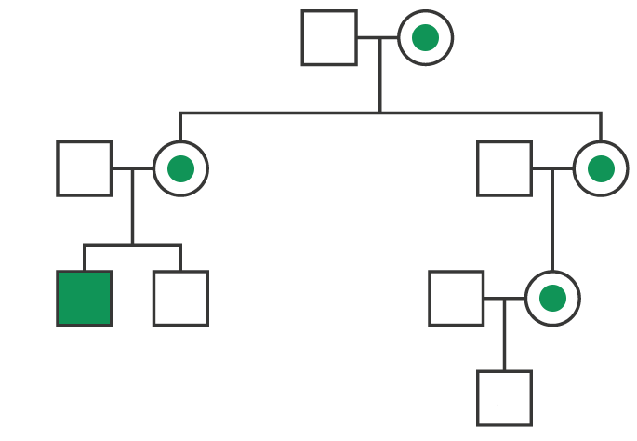
Family history

Slide 67
Family history
Do other members of the family have the same or related disorder?
What is the expected inheritance pattern (dominant/recessive, sex-linked/autosomal)?
If sex-linked, filter variants by chromosome.
Can we get genotypes for the patient’s parents and affected family members for prioritised variants?
Does this match what we expect from the inheritance pattern?

Slide 68
Inheritance patterns of the known phenotype
Dominant/recessive/haploinsufficient/ homozygous-lethal
Does the genotype at a prioritised locus match the expected genotype for this phenotype?
Does it match the inheritance pattern from the family history?

Slide 69
Hands on
Demo
The file genomics.human_genetic_variation.DemoVEP.vcf that we used in the VEP Demo includes variants from an individual with neurofibromatosis.
We’re going to filter our VEP results to identify variants that might be causal to take forward for further study.
Task
Please complete task 3.
Notes:
NF selected variant = 22 23803323 . C G, missense SMARCB1
CdLS selected variants = 8 116858441 . T G, missense RAD21, 10 110589944 rs863225260 G A, missense SMC3

Slide 70
Neurofibromatosis genes
COQ2
COQ6
LZTR1
MAP2K2
NF1
NF2
SMARCB1

Slide 71
G2P plugin – script only
The G2P plugin is very useful for clinical interpretation as it filters your VEP data to give only variants that:
Fall within a gene on the G2P list of genes known to be linked to clinical phenotypes
Have a severe consequence which is likely to affect protein function
Are novel or have a low frequency
Variant hits match the allelic requirement of the gene
If a trait depends on recessive inheritance, both copies have at least one variant that passes all other filters
If the trait is dominant, only one copy needs a variant
Only available with the VEP script:
https://www.ebi.ac.uk/gene2phenotype/g2p_vep_plugin

Slide 72
G2P plugin files
gene symbol | gene mim | disease name | disease mim | DDD category | allelic requirement | mutation consequence | phenotypes | organ specificity list | pmids | panel | prev symbols | hgnc id | gene disease pair entry date
HMX1 | 142992 | OCULOAURICULAR SYNDROME | 612109 | probable | biallelic | loss of function | HP:0000007 | Eye;Ear | 18423520 | DD |  | 5017 | 22/07/15 16:14
CEP290 | 610142 | BARDET-BIEDL SYNDROME TYPE 14 | 209900 | confirmed | biallelic | loss of function | HP:0000256 | Kidney Renal Tract;Brain/Cognition |  | DD |  | 29021 | 22/07/15 16:14
FLNA | 300017 | OTOPALATODIGITAL SYNDROME TYPE 1 | 311300 | confirmed | hemizygous | uncertain | HP:0003196010109 | Face;Skeleton;Brain/Cognition | 15654694;16596676;15940695;12612583 | DD | FLN;OPD1;OPD2;FLN1 | 3754 | 22/07/15 16:14
SLX4 | 613278 | FANCONI ANEMIA COMPLEMENTATION GROUP P | 613951 | confirmed | biallelic | loss of function | HP:0000414 | Bone Marrow/Immune;Skeleton;Brain/Cognition | 21240275;21240277 | DD | BTBD12 | 23845 | 22/07/15 16:14
Publicly available lists or you can make your own:
Decipher https://www.ebi.ac.uk/gene2phenotype/downloads
PanelApp https://panelapp.genomicsengland.co.uk/

